Slide 1
Flux & React
Web Application Development
Mark Repka, Rich McNeary, Steve Mueller

Slide 2
Topics Covered
Introduction to Web Development
  Get to know some of the basic terms and technologies for general web software
Flux
  An architecture for building client-side web applications
React
  A JavaScript library for building user interfaces
Closing notes
  Main things to remember
Live Demo
Questions?

Slide 3
Introduction to Web Development
HyperText Markup Language (HTML)
  The standard markup language used to create web pages
  Consists of tags enclosed in angle brackets: <html>something</html>
Cascading Style Sheets (CSS)
  The standard style sheet language used for describing the look and formatting of a document written in a markup language, usually HTML.
  Uses a JSON-like structure to define classes and attributes for each HTML tag
JavaScript (JS)
  Also known as ECMAScript
  Programming language of HTML and the Web
  Enables many more dynamic features of websites and web applications

Slide 4

Flux
An architecture for building
client-side web applications

Slide 5

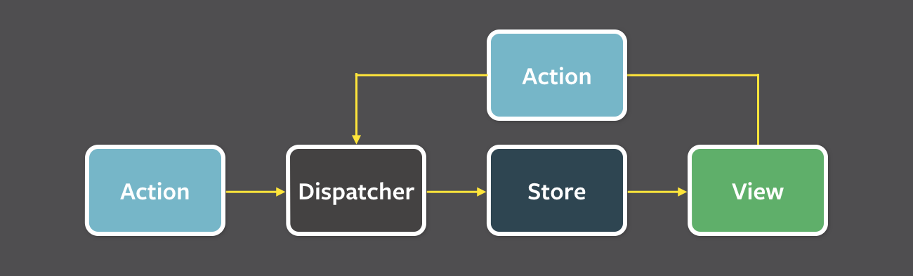
Flux Overview
Data in a Flux application flows in a single direction:
NOT a code library.
  This is just a design pattern
Flux applications have three major parts
  Dispatcher
  Stores
  Views (React Components)
Structure and Data Flow
  Unidirectional data flow is central to the Flux pattern
  The dispatcher, stores and views are independent nodes with distinct inputs and outputs
Designed by Facebook and Instagram
Provided as Open Source software
The views may cause a new action response to user input

Slide 6
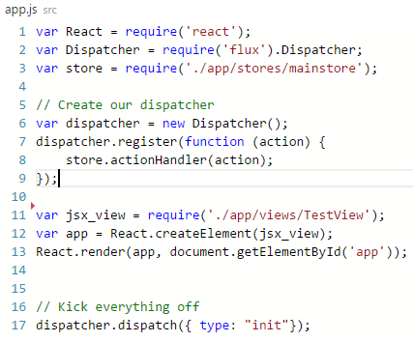
Flux: Dispatcher
The dispatcher is the central hub that manages all data flow in a Flux application
Has no real intelligence of its own
  It is a simple mechanism for distributing the actions to the stores
Each store registers itself and provides a callback
All stores in the application receive the action via the callbacks and can choose to act on them
Facebook, the creators of Flux, provide code for an example Dispatcher to get started. This is seen in the require(‘flux’).Dispatcher statement in the code to the right.

Slide 7
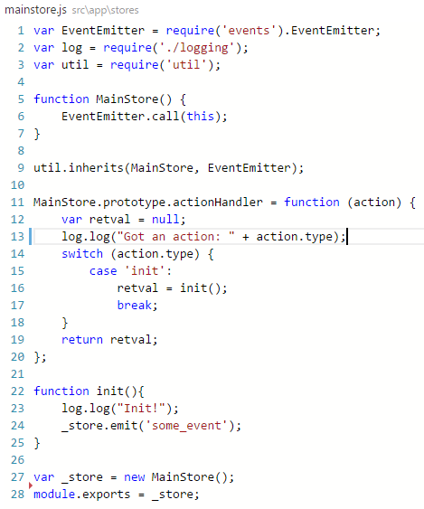
Flux: Stores
Stores contain the application state and logic
  Similar to the model and controller in a traditional MVC application
Registers itself with the dispatcher and provides it with a callback
Contains a switch statement that can decide what to do with various actions that are dispatched by the Dispatcher
Emits events to any listening Views telling them to update their internal state

Slide 8

Flux: Views
Flux was designed to pair well with the React library which provides the UI side of your web application
When an action is captured by the store an event is emitted to any view that is listening to that store.
The view calls its own setState( ) or forceUpdate( ) methods to update accordingly
  More on this in the React section next…
React

Slide 9
React
A JavaScript library for
building user interfaces

Slide 10
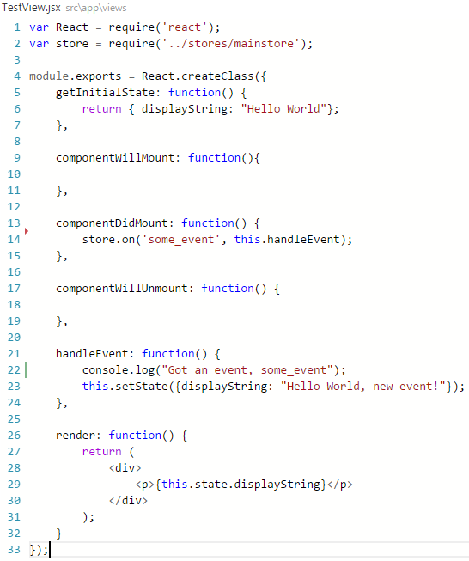
React Overview
Just the User Interface
  Handles the V in the MVC design pattern
Simple Components
  Each react component handles one thing
Usually written in JSX format
  Allows for XML/HTML-like syntax directly
  in the JavaScript code
Translates directly into JavaScript
  Can be run directly in a standard web browser with no additional libraries required
Designed by Facebook and Instagram
  Powers the UI of both of these websites
Provided as Open Source software

Slide 11
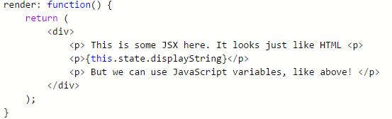
React: Intro to JSX
JSX is a JavaScript syntax extension that looks similar to XML/HTML
Offers a concise and familiar syntax for defining components with optional attributes and state
It's more familiar for casual developers such as designers
Each React component is displayed through its render function. This function returns some JSX that defines how the component will display on the page.

Slide 12
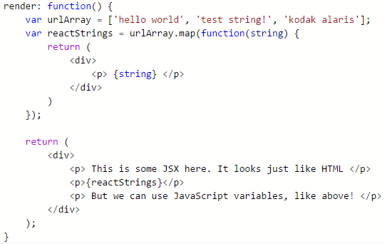
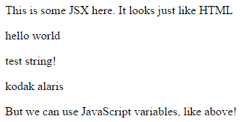
React: Intro to JSX
This Render function and some helper JavaScript variables lets us do some really useful things!
Dynamically creating a number of React components from values in a JavaScript array

Slide 13
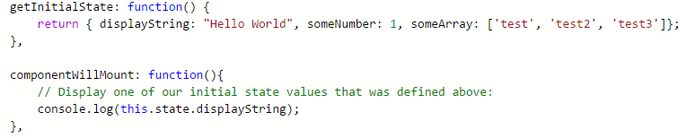
React: Component State
More complex React components can have some state information that helps them decide how they should render and display.
  This could include data like our little example array from before
Some initial state can be defined in a component by overriding the getInitialState( ) function

Slide 14
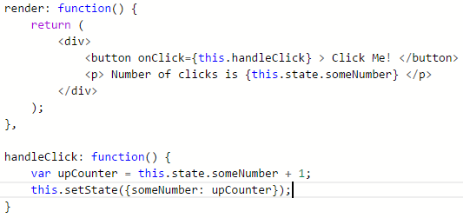
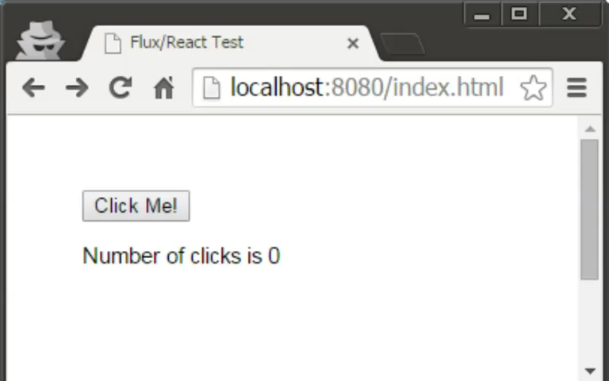
React: Component State
If the state changes it will trigger a call to the render method so the component can be updated
In this simple example, state is just a single integer value called ‘someNumber’ which holds the number of clicks
Web Browser View

Slide 15
React: Component Lifecycle
Components have three main parts of their lifecycle
Mounting: A component is being inserted into the DOM
  getInitialState( ) is invoked before a component is mounted
  componentWillMount( ) is invoked immediately before mounting occurs
  componentDidMount( ) is invoked immediately after mounting occurs
Updating: A component is being re-rendered to determine if the DOM should be updated
  shouldComponentUpdate( ) is invoked when a component decides whether any changes warrant an update to the DOM
Unmounting: A component is being removed from the DOM
  componentWillUnmount( ) is invoked immediately before a component is unmounted and destroyed. Cleanup should go here

Slide 16
React: Virtual DOM
One of the most important things in any application, web or otherwise, is performance. React has some very interesting features to help improve its performance over other popular web frameworks.
The Document Object Model (DOM)
  Structured representation of a document - in this case our web page
  A tree structure of nodes and objects that each can have different properties and methods
Interacting with this DOM ourselves is slow and tricky to handle correctly. React removes this difficulty of dealing directly with the webpage DOM by introducing the idea of a Virtual DOM

Slide 17
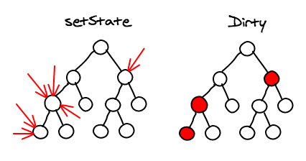
React: Virtual DOM
Whenever you call setState( ) on a component, React will mark it as dirty. At the end of the event loop, when all of the render methods have cascaded through, React looks at all the dirty components and compares the result of the new state to the existing DOM and does a single calculated update.
This means that, per any number of updates in that event loop, there is exactly one time when the DOM is being updated.
http://calendar.perfplanet.com/2013/diff/
Facebook Software Engineer, Christopher Chedeau

Slide 18
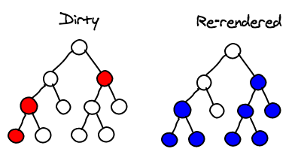
React: Virtual DOM
This method is great news for performance since we are usually only updating nodes at the bottom of the tree, not at the top!
This means that changes are localized to where the user interacts and does not normally involve updating the entire DOM each time.
http://calendar.perfplanet.com/2013/diff/
Facebook Software Engineer, Christopher Chedeau

Slide 19
React: Helpful Addons
When building an application with React there are some extra features that make development even easier
Localization with react-intl
  Open Source library provided by Yahoo
  Uses the standard ICU Message syntax
  Provides React Components format data and strings
Animations
  React provides the ReactCSSTransitionGroup
  Supports basic CSS animations and transitions
  Wraps all of the components you are interested in animating
  Specified in CSS file by some name, referenced in code by that name

Slide 20
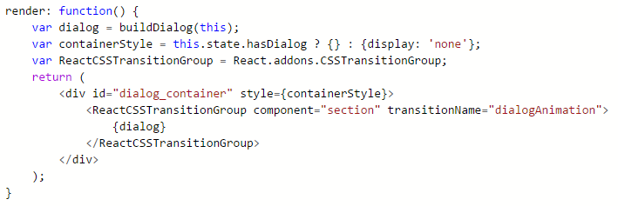
React: Animations
The ReactCSSTransitionGroup addon allows for CSS transitions and animations when a React component enters or leaves the DOM
Animations are then specified by name in the CSS

Slide 21
Closing: Things to Remember
React helps you create small simple components can be easily reused throughout the application
Components can be combined together to create more complex interfaces
React will automatically manage all UI updates when your underlying data changes
Page markup and JavaScript behavior are defined together in the same file, the JSX format, making code easy to read and follow
Designed for performance with large complex web applications
Cross browser support in Firefox, Chrome, IE8+, Safari, etc.
Used by industry leaders such as Facebook, Instagram, Netflix, Codecademy

Slide 22
Live Demo!
Lets check out React and Flux in action…

Slide 23
Example Code and Resources
https://github.com/repkam09/react-flux-test
  Contains all code shown in this presentation
http://facebook.github.io/flux/
  The official documentation for Flux, provided by Facebook.
https://facebook.github.io/react/
  The official documentation for React, provided by Facebook.

